Slide 1

@zinecat #NYCDHWeek
Zine Union Catalog Bringing Together Disparate, Unruly Metadata https://is.gd/zuc_at_nycdh2020
Notes:
Introductions Jenna + Lauren will introduce each other
Lauren Kehoe is the Undergraduate Instruction and Outreach Librarian here at NYU, and she also focuses on accessibility. She has served as ZineCat's metadata-ist, front end developer, blogger, grant researcher, zine importer, and shill. Lauren is an exceptional project partner, and the human of two dreamy cats: Peanut and Baby Yoda.
Jenna is the Zine Librarian and Associate Director of Communications at Barnard College. She’s the BEST project partner and it’s been a joy to work with, and learn alongside, Jenna over the last 3.5 half years. We have been lucky

Slide 2
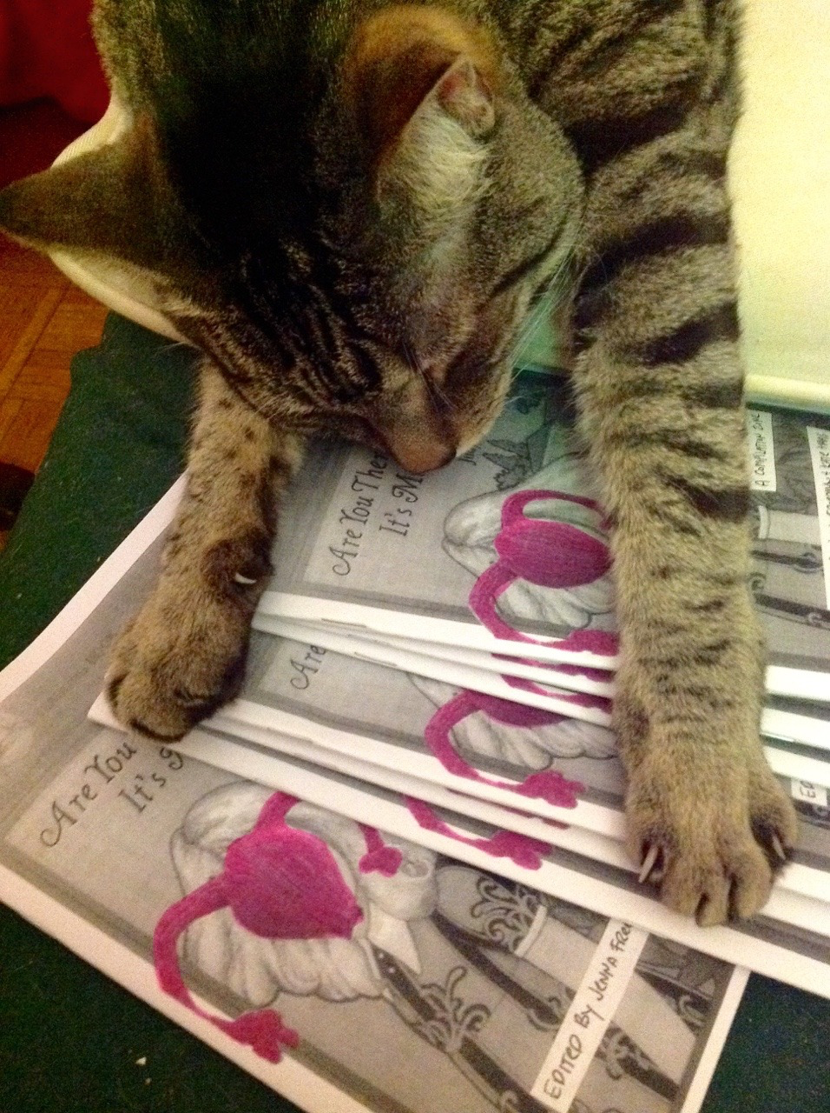
@zinecat #NYCDHWeek
What is a zine?
Photocopies
Foldy zine activist culture
Self published +1 +1
Local metadata schemas
Handmade
Where are zines?
How are they found?
Notes:
JENNA
Some of you may already have experience with zines.
For those who didn't, before they walked in here, now you do, because you're holding a zine in your hand.
We'll ask everyone to say one word or phrase they associate with zines. Repeats okay. Saying "pass" okay.
[Lauren will fill in audience responses to what are zines…]
DIY - like this definition
Zine definition: Short for fanzine or magazine,
Self published,
self made,
Print based, -- usually on paper,
copies made using a copier,
often addressing countercultural topics or underrepresented voices.
Self expression,
not for profit.
----------------------
Zines are collected all over! https://zines.barnard.edu/zine-libraries
Title of project and what does this project do?
Add problem statement intro here - Zines are information rich, but across disparate locations and the ZUC will unify these resources into one search platform
Takeaways: 1. Zines are across many collections, but are now searchable in one interface. 2. Struggled for a long time and now have some progress on developing a Union Catalog. 3. Intellectual work of creating a mapping and standardization of messy metadata.

Slide 3
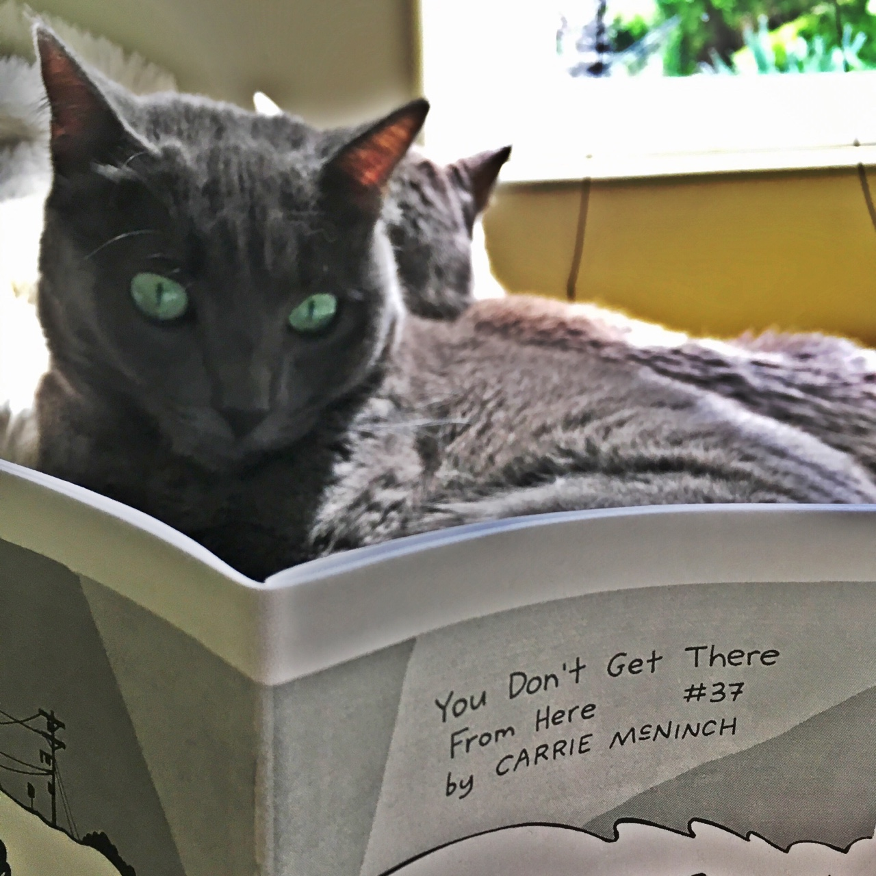
@zinecat #NYCDHWeek
ZUC: What Is It?
It's like a WorldCat or DPLA for zines!
Shared
Benefits
Scholars
Zinesters
Zine librarians
Notes:
LAUREN
Why there is a cat on the slide
Zine + cat (and it's reading a zine and probably wondering where to find more zines like it, which is VERY META, and we're all about metadata)
It's like a WorldCat , but NOT evil (or Digital Public Library of America) for zines.
Union catalog: one-stop place for finding out about zines & where they're held:
known & unknown item searches, e.g., transgender kids

Slide 4
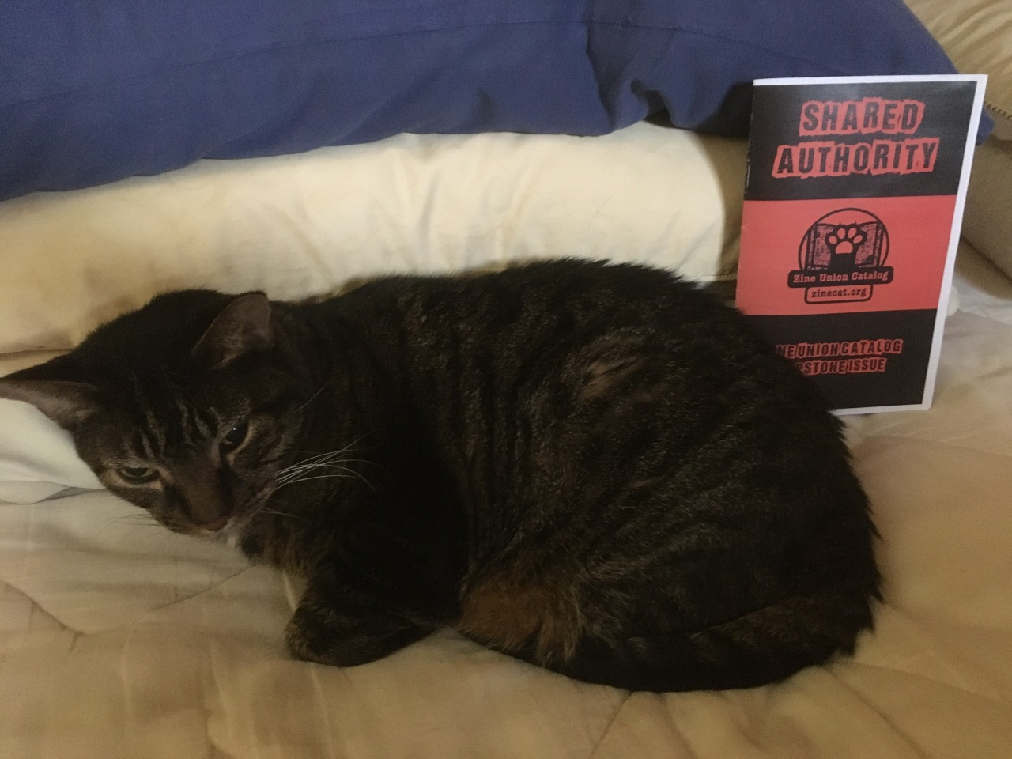
@zinecat #NYCDHWeek
Collective Access, an Open Source DAM
Compared with Omeka
Open source
QZAP
Active community, including in NYC, where the application is developed
Notes:
LAUREN
https://docs.google.com/document/d/1jiBS0GJlknOQ-zKn20RQ2ZFGEWdWN0dwmAmc82xXiOo/edit
Zine Cat was built using Collective Access - an open-source digital asset management system that can be used for private and public-facing collections.
Collective Access allowed us to design a mapping schema that would make it easy to normalize data. Our current schema only includes the most essential fields - title, author, details about where and when it was created, and details about the source collection.
All that needs to be done to participate in ZineCat is to export metadata according to our mapping schema
PRO Locally operated and mom&pop shop. CA user group community
CON: not as easy to navigate as some of the other options out there?
TOP: Sample metadata from Queer Zine Archive Collection
BOTTOM: Our mapping schema
RIGHT: What you see on the Zine Union Catalog
TOP: Sample metadata from Queer Zine Archive Collection
BOTTOM: Our mapping schema
RIGHT: What you see on the Zine Union Catalog

Slide 5
@zinecat #NYCDHWeek
We have created a single map that creates a representation of records consisting of elements of xZINECOREx (based on Dublin Core):
Creator
Subjects/genres
Content description, notes
Publisher(s)
Contributor(s)
Date of publication
Format description
Identifiers (union ID)
Source
Language
Relation (see also)
Coverage (place of publication)
Rights (freedoms and restrictions)
Notes:
JENNA
Zinecore is currently pretty much just a punked out Dublin Core with slight tweaks.
Used by QZAP, ABC No Rio, Minneapolis Community and Technical College
Follow the link for a zine made by Milo Miller of QZAP

Slide 6

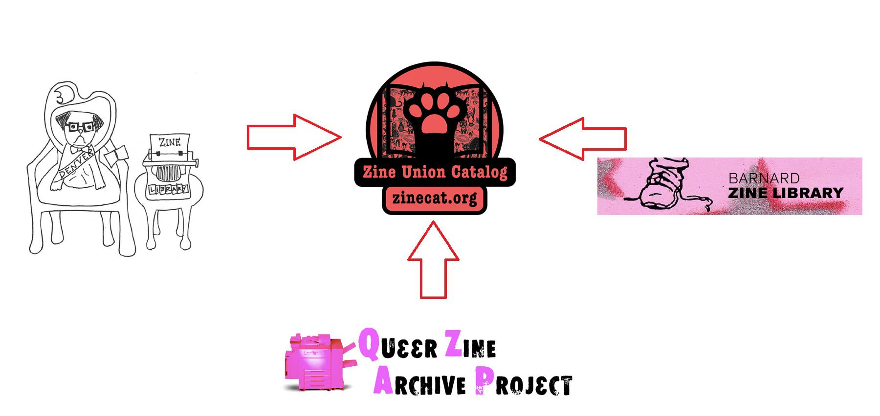
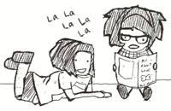

ZineCat Libraries & Archives (so far!)
Notes:
LAUREN
The ZineCat prototype takes metadata from six different collections (capital L, libraries and lowercase L libraries for equitable representation), thus including more than 30,000 zines in the prototype
Two academic libraries, one archive and one special collection, public libraries, and one barefoot library, one of which is programmatically digital.
Denver Zine Library (homegrown), Barnard Zine Library (MARC), and the Queer Zine Archive Project (ZineCore), Carnegie Library of Pittsburgh (Library Thing), ABC No Rio (ZineCore-esque), Sallie Bingham Center Zine Collections at Duke University.

Slide 7
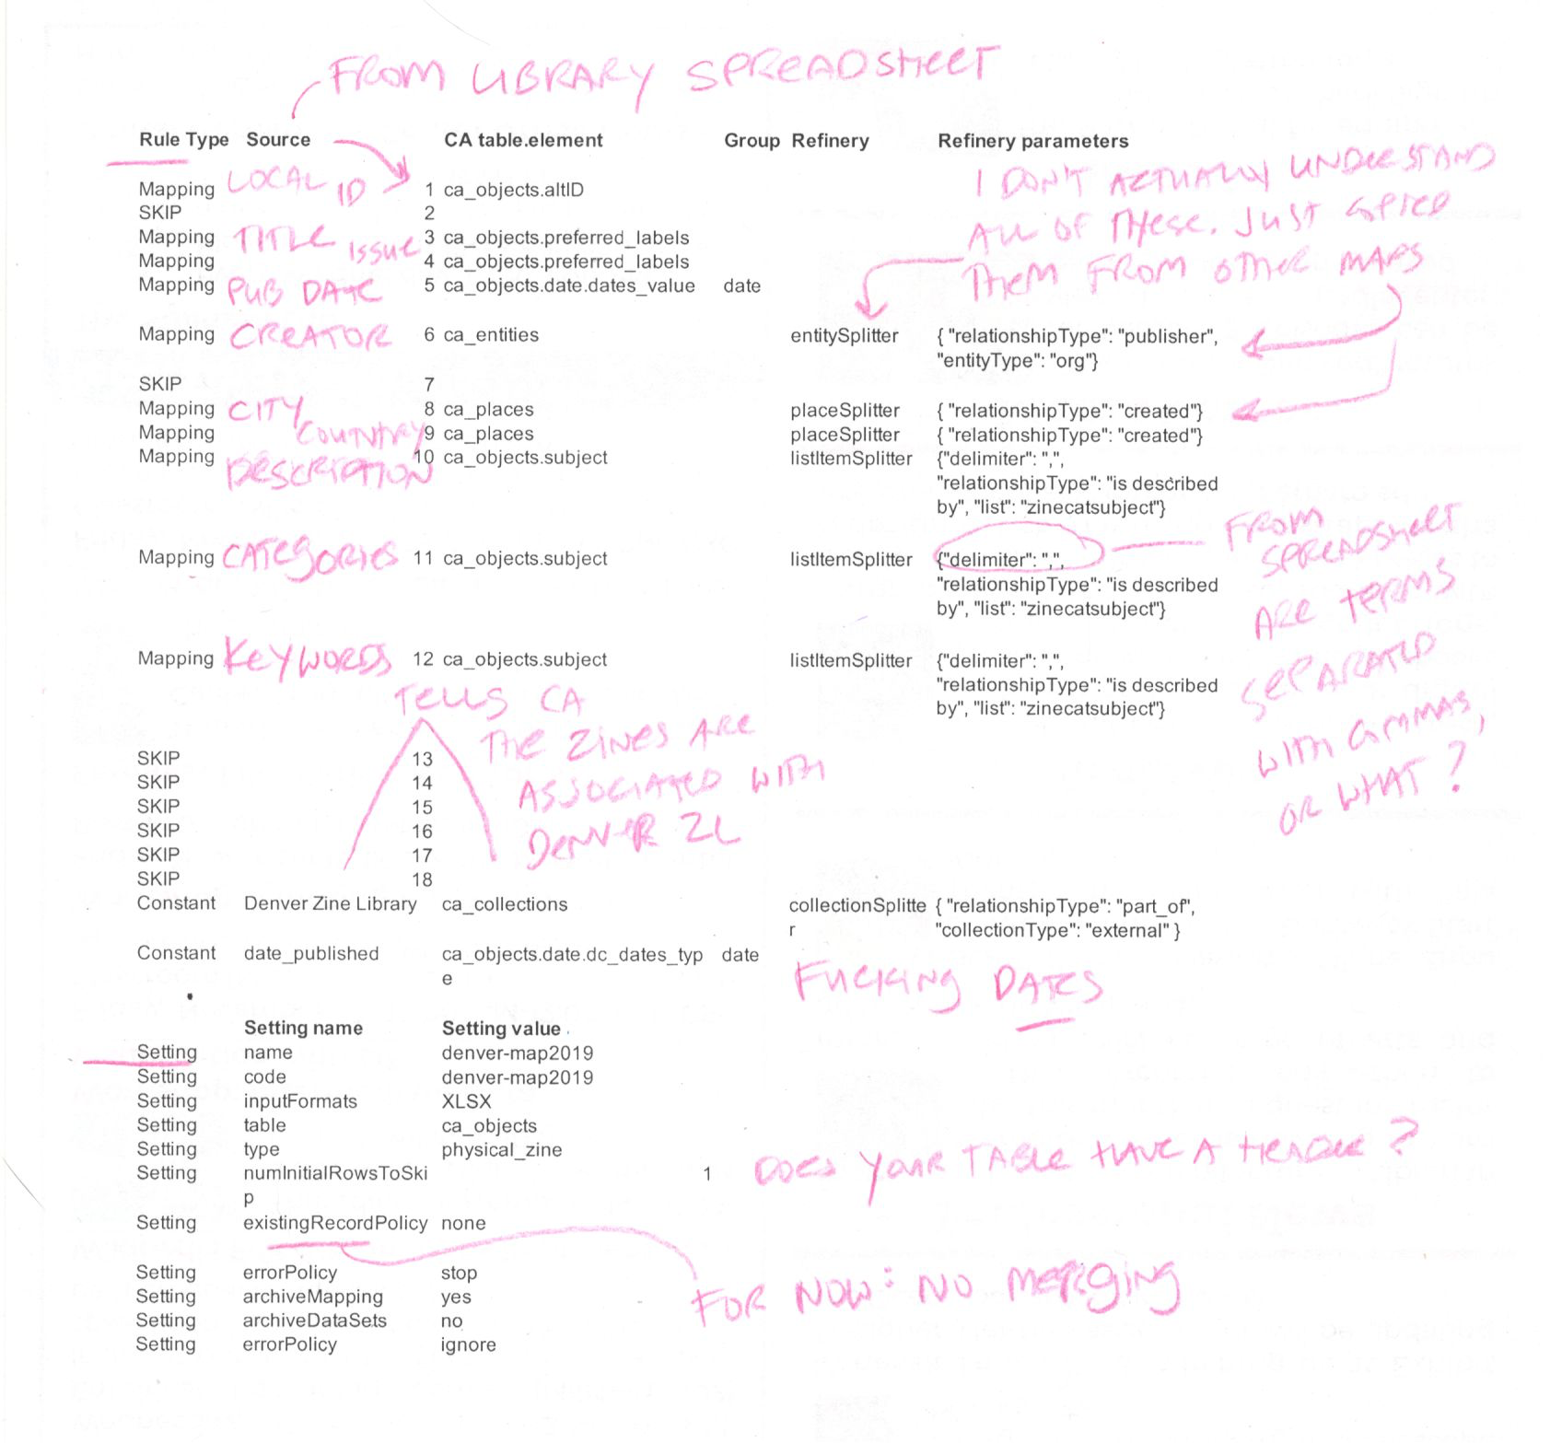
Notes:
JENNA
Sample metadata application profile (MAP) from a collection
Our mapping schema
This mapping schema imports the zine along with its details, and treats the creator and the collection as independent elements that exist in relationship to one another.
Basically you have your spreadsheet, which you have to tell CA how to read.

Slide 8
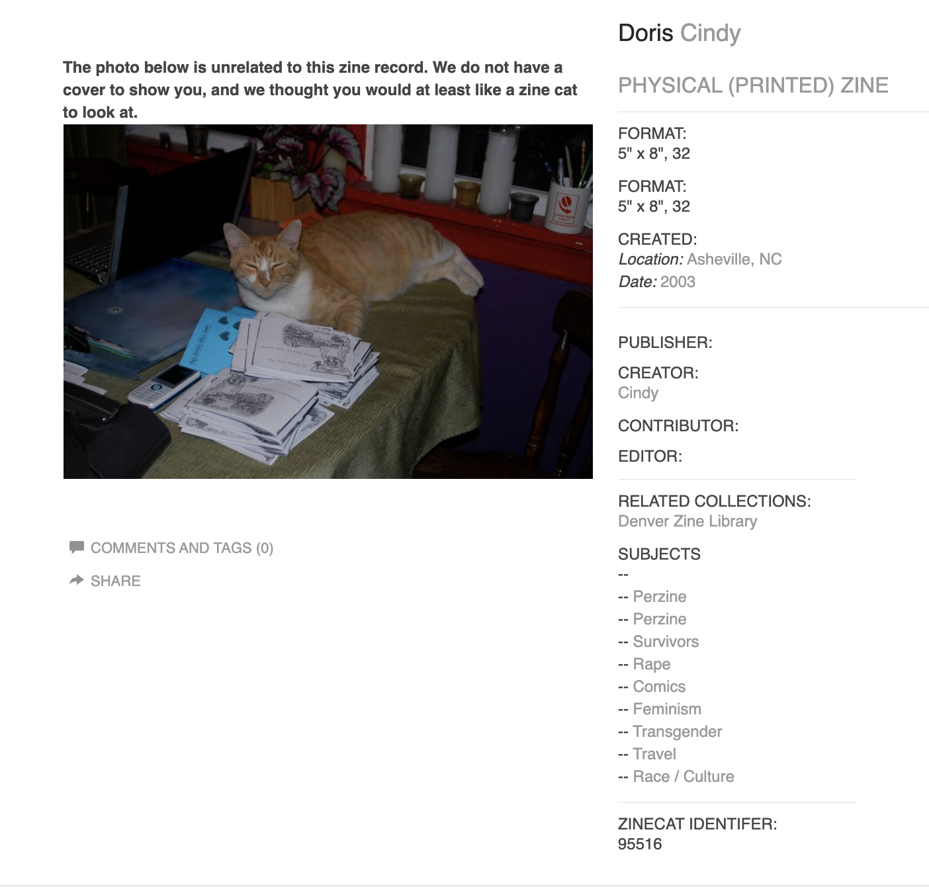
@zinecat #NYCDHWeek
Notes:
LAUREN
You can click on the entity to find all the information relevant to this creator. You can search author names, collection names, etc.

Slide 9
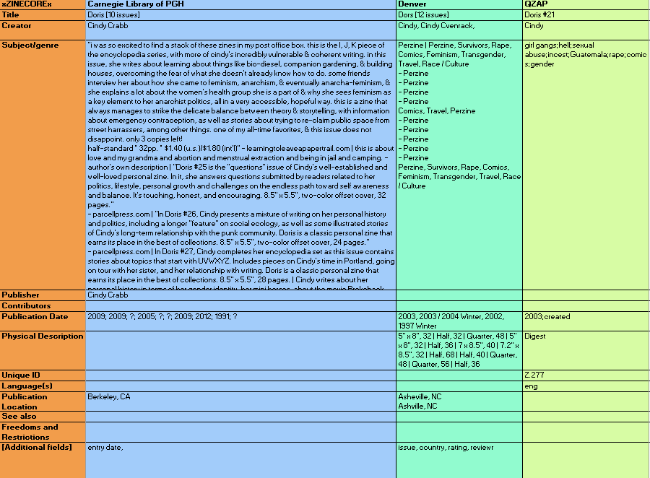
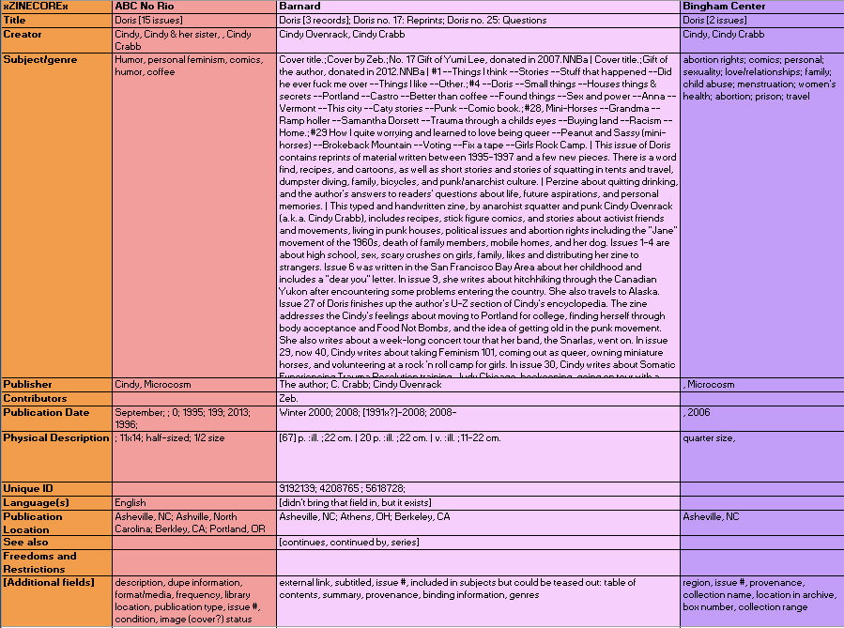
@zinecat #NYCDHWeek
Notes:
JENNA
Look at how easy it all is! JK
Discuss varieties of metadata and how exciting harmonization can be.
Mention serials & monographs, too.

Slide 10
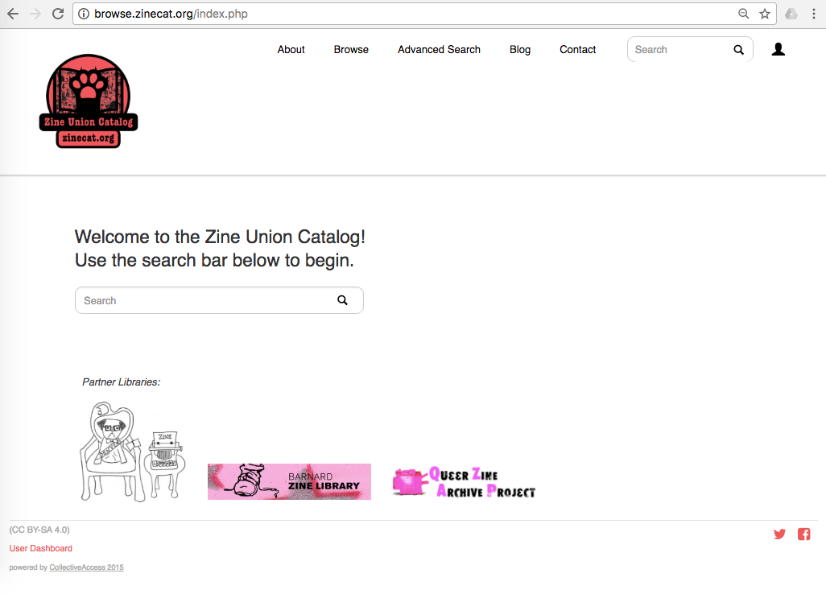
@zinecat #NYCDHWeek
And now for a live searching… zinecat.org
Give these a try:
Secret Asian Man
Picklejar
Queer
Punk
Elvis
Notes:
LAUREN
Disclaimer: we have not yet tested multiple users searching at the same time, so let’s see what happens.
Encourage everyone in the audience to do a search. Some suggested searches are:
Queer
Punk
Elvis
Secret Asian Man
Picklejar

Slide 11
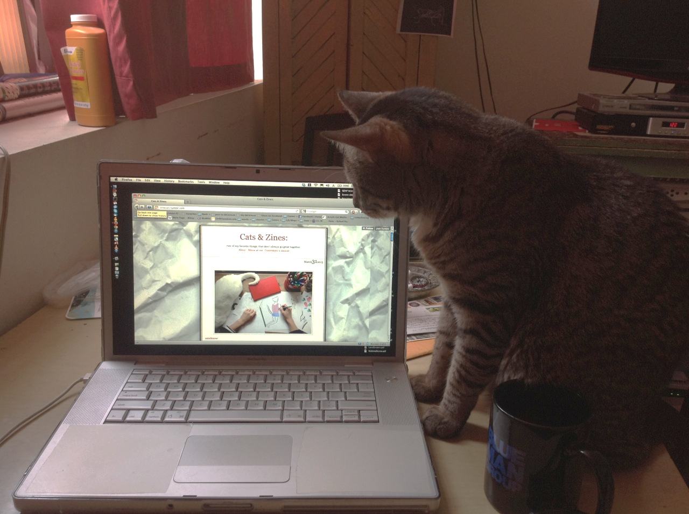
@zinecat #NYCDHWeek
Future & Next Steps
More libraries
Better field harmonization
Mutual metadata (that's anarchist for "authority control")
Record overlays
External link fixes
A big bag of money, or several small and medium-sized bags of money
Maybe you?
Notes:
JENNA
Add more records from current three collections and from more libraries.
We have records ready to upload in our GitHub repository from, among others
Anchor Archive, which has its own subject thesaurus
Minneapolis Community and Technical College with another standalone catalog that uses ZINECORE
Ontario College of Art & Design with its records currently hosted on ARTstor
More sophisticated use of mutual metadata
Establishing authority files for creators
Subject thesaurus
leveraging linked open data--all about relationships now, and CA's strength is drawing out such relationships.
Zine Librarians group and ZineCat Group are in one email list-->working together
Clean up all the messy shit

Slide 12
@zinecat #NYCDHWeek
Zine Making
Followed by Cataloging & Discussion
Make a zine about:
What is your DH project?
Write a letter to Franco Moretti (Graphs, Maps, and Trees guy)
Share your favorite tech tips
Make an openrefine for beginners mini-comic/haiku anthology
Cats: Love, Hate, or indifference
Notes:
LAUREN
Jenna and Lauren will present on the ongoing development of the The Zine Union Catalog (ZUC) evolving through their work at the CUNY GC. Participants will receive an overview of the project and catalog, how it's developed, where it's headed, and how the project both used an open source DAM platform to aggregate open data and how the project grapples with the problems inherent in sharing information online (i.e. with respect to zine author anonymity, etc.). Participants will also be introduced to the Zine Librarians Code of Ethics and will make their own zines about the OpenCon 2018 as well as create metadata for their zines.
Some Zine Making suggestion prompts:
What is your DH project?
Write a letter to Franco Moretti (Graphs, Maps, and Trees guy)
Share your favorite tech tips
Make an openrefine for beginners mini-comic/haiku anthology
Cats: Love, Hate, or indifference

Slide 13
@zinecat #NYCDHWeek
Metadata Elements
How do you describe your work?
How will a zine librarian describe it?
Notes:
JENNA

Slide 14
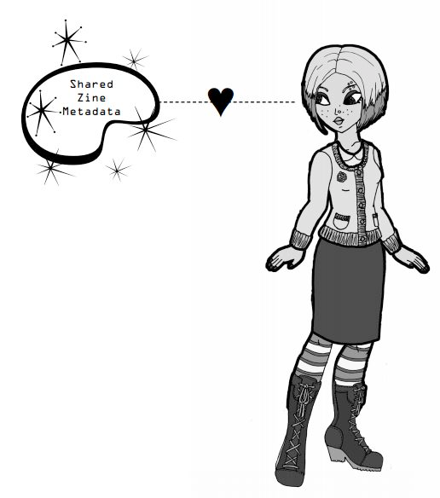
@zinecat #NYCDHWeek
Credits & Links
Website zinecat.org
Email zinecatproject@gmail.com
Repository https://github.com/zinecat/zinecat.org
Collective Access collectiveaccess.org
Zine Union Catalog on zinelibraries.info zinelibraries.info/zine-union-catalog
Zine Librarians Code of Ethics https://zinelibraries.info/code-of-ethics/
Cat photos zinecats.tumblr.com
Graphic by Milo Miller qzap.org

